Slide 1
APBD – lecture 1
Introduction to VCS
Introduction to .NET
Basics of C#

Slide 2
Internship possibility
Cooperation with companies
Senfino AI
Kinetix Trading Solutions
Possibility of internship after classes

Slide 3
Basics of working in terminal
cd folderName changing the root directory
cd .. going one level up in the directory structure
cd „C:\Users\Piotr\Desktop\Projects” you can also provide full path to file
mkdir nameOfDir creating a new directory with specific name
rmdir nameOfDir removing a directory with specific name
ls listing files in the current location (names, permissions, creationd date, etc.)
clear removing text from the console
pwd print the current path
Additional materials - https://www.youtube.com/watch?v=5XgBd6rjuDQ https://www.youtube.com/watch?v=Us3G-nJYru0

Slide 4
Basics of working in terminal
You can git the up button to get the previous command you have typed in

Slide 5
What is “version control”, and why should you care?
Version control is a system that records changes to a file or set of files over time so that you can recall specific versions later.
If you are a graphic or web designer and want to keep every version of an image or layout you have designed
If you are a programmer you want to keep track of the changes in code (especially if you are working in a team).
It allows you to revert selected files back to a previous state, revert the entire project back to a previous state, compare changes over time, see who last modified something that might be causing a problem, who introduced an issue and when, and more.

Slide 6
What is “version control”, and why should you care?
Using a VCS also generally means that if you screw things up or lose files, you can easily recover. In addition, you get all this for very little overhead.

Slide 7
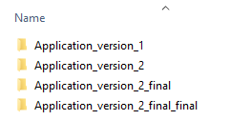
Local Version Control Systems
The simplest example of the local version control system
Simply copying the work „just in case” – so that we won’t by any change destroy our previous work

Slide 8
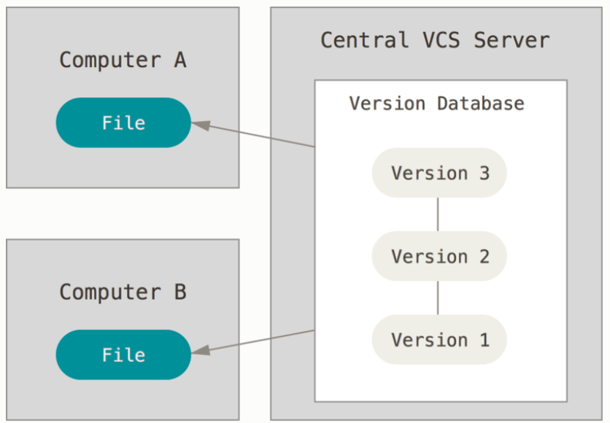
Centralized Version Control Systems
Next major problem that people encounter was the need to collaborate with developers on the same codebase/system.
To deal with this problem a Centralized Version Control Systems (CVCSs) were created – for ex. CVS, Subversion, Perforce)

Slide 9
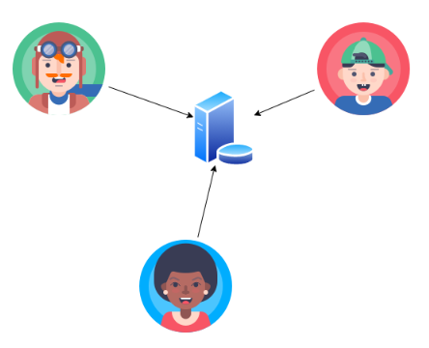
Centralized Version Control Systems

Slide 10
Centralized Version Control Systems
CVCSs have a lot of advantages – for ex. everyone knows to a certain degree what everyone else on the project is doing.
Administrators can control exactly who can do what
The downside is that CVCS has a single point of failure. If the server goes down for an hour – nobocy can collaborate at all, save the changes or do anything else.
If the hard disk of the central database becomes corrupted, and proper backups haven’t been kept – we lose absolutely everything – entire history of the project. Only local snapshosts on users’ local machiune wil be left out.

Slide 11
Distributed Version Control Systems
DVCSs (Git, Mercurial, Bazaar, Darcs) – is the answer to previous problems. In DVCSs the clients dont just check the latests snapshot of the files. They fully mirror the repository, including its full history.
Even if the server will die, we can still re-create the whole repository history just from a single copy.

Slide 12
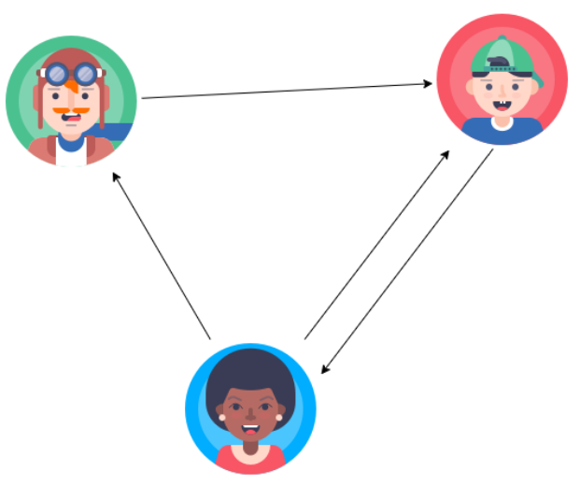
Distributed Version Control Systems

Slide 13
Why we are using Git?
Free
Open source
Fast
Scalable
Often the main version control system used in many companies you will be working with.
Allow you to easily track history and collaborate on a single project
Probably the most often used version control system

Slide 14
Git - tools
Git is a console tool. You can download it here
https://git-scm.com/downloads
During the installation you can pick all the default choices
There are a lot of GUI tools for Git and we will also use a few of them – Source Treem Git Kraken etc.
On the same website you can also find a free book about Git
https://git-scm.com/book/en/v2
Remember that GUI tools won’t allow you to use all the functionality that Git offers. Thats why its good to learn the basics of working in the terminal.

Slide 15
Git - configuration
We have a few settings we should set up after installing Git.
Git allows us to set configuration at a few levels:
System – for all users
Global – for all repositories of the current user
Local – the current directory
There are a few things we should set up: our user email, user name and how to deal with line endings.
git config –global user.name „Piotr Gago”
git config –global user.email „pgago@pjwstk.edu.pl”

Slide 16
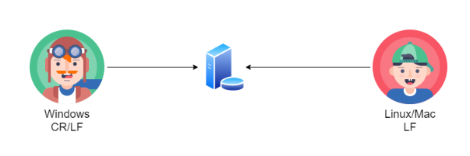
Git - configuration
One more thing we should deal with are line endings.
git config –global core.autocrlf true on Windows
git config –global core.autocrlf input on Mac/Linux

Slide 17
Git - help
You can get help about specific command in git using:
git config –help this way we will get help about the config command
https://git-scm.com/docs official documentation

Slide 18

Additional console tools
To make working with git a little easier you can install additional tools. They will help you to visualize in the console the state of the current git repository.
They are not required.
It works on Windows
https://github.com/dahlbyk/posh-git

Slide 19
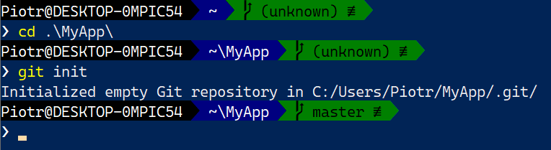
Git – creating a new repository
To create a new in the current location we use the following command:
git init
In the example below it means that the whole content of the „MyApp” folder will be under version control system.

Slide 20
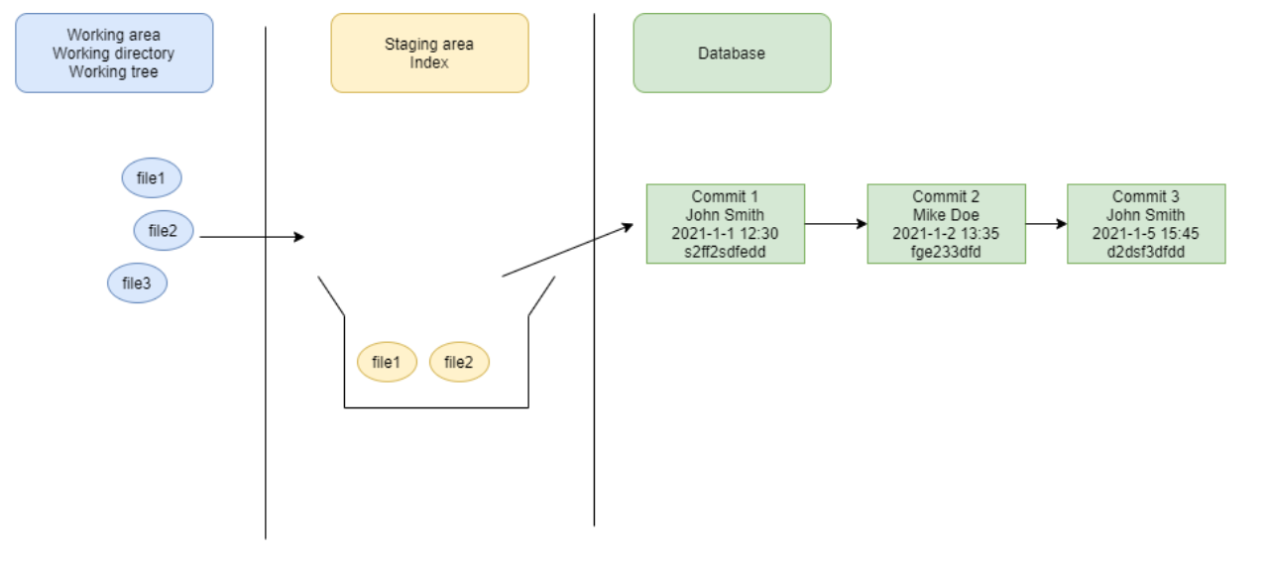
Git workflow

Slide 21
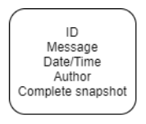
Git commit
Every commit represents a full snapshot of the specific version of our repository (from specific point in time)

Slide 22
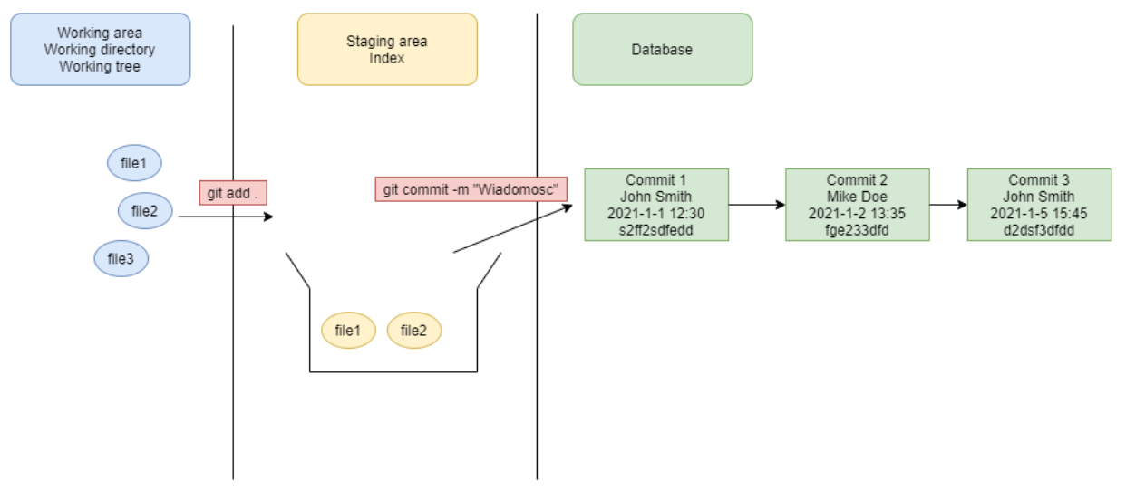
Git workflow - example

Slide 23
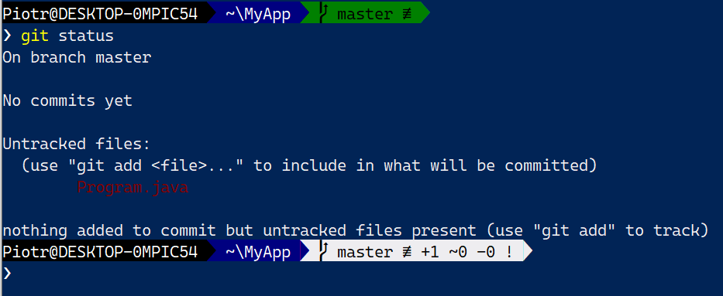
Git – checking the status of repository
git status

Slide 24
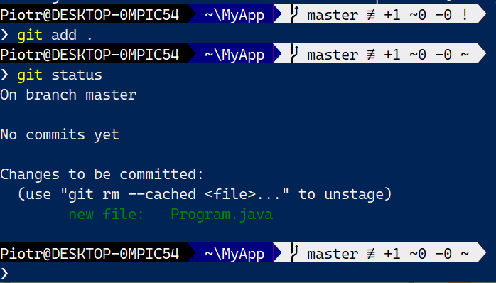
Git – staging files
git add program.txt
git add models/*
git add *.java
git add . adding all detected changes to staging area

Slide 25
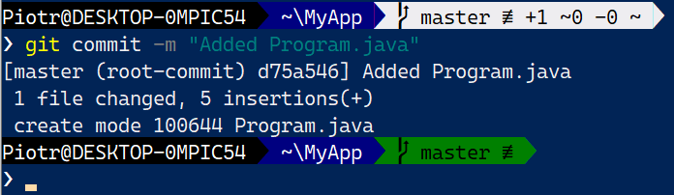
Git – create commit
git commit –m „Short description of the commit”
git commit without the „m” parameter – you will need to type the message in default text editor for Git.

Slide 26
Git – committing – best practices
The size of the commit matters. Commit should not be too small, for ex:
„Added System.out.println”
„Added int a”
„Added field FirstName to student”
Too many small commits make history hard to follow. We have thousands of commits representing tiny changes.

Slide 27
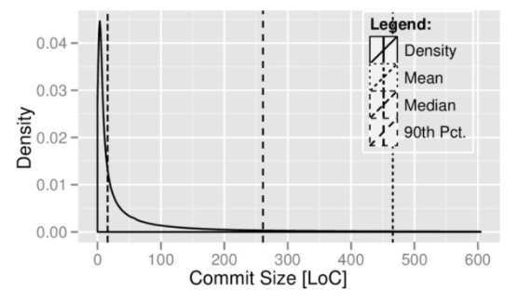
Git – committing – best practices
Too large commits are also a „bad thing”.
Typical commit size is up to 100-150 lines of code

Slide 28
Git – committing – best practices
How to describe your commit?
Commit message should be short
Descriptive
It can include link or id of the task assigned in some kind of tasking system (for ex. Jira)
We can use:
PRESENT: Fix the bug associated with FB login
PAST: Fixed the bug associated with FB login

Slide 29
Git – display history
We can display the local history using the following commands.
git log
git log –oneline
git log –oneline –reverse

Slide 30
Git – Ignoring files
Sometimes, we can encounter individual files that we should not store in the repository.
We can use .gitignore file to „tell git” which files should be ignored by it.
It will only work if the ignored files are not yet added to the history of the repository
Examples of .gitignore files can be found at
https://github.com/github/gitignore

Slide 31
Git – Discarding the local changes
Sometimes you may like to remove the current/unsaved changes from the repository.
We can think about it as resetting the repository to the last saved commit
git reset –hard
git clean -df

Slide 32
Git – restore a file to the previous version
We can restore any previously saved file and save it as the new commit
git restore --source=HEAD~1 Program.java

Slide 33
Git – Example in IntelliJ
During our exercises please use JetBrains IntelliJ IDEA for Java development
You can download a free, community version
There are versions for Windows/Mac/Linux
https://www.jetbrains.com/idea/download/#section=windows

Slide 34
Git – github, bitbucket, gitlab
Git by itsels save the changes only to our local database. It does not provide any way of sharing the repository with other users.
For this purpose we usually use additional services/websites like:
https://github.com/
https://bitbucket.org/
https://about.gitlab.com/
And others...
Often companies have their own, private servers for code repositories
We will use GitHub during the course of our subject.

Slide 35
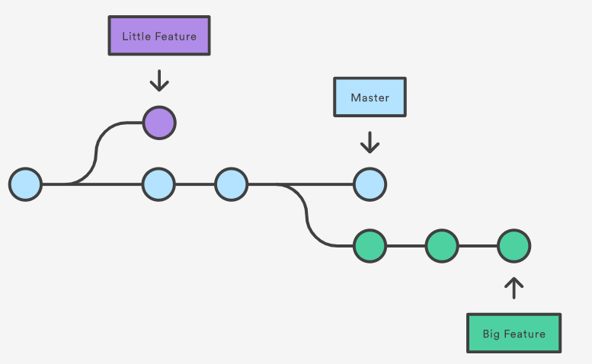
Git - branch
Branch is represented by a list of connected commits. Those commits represent the history of our repository.
We can have more than a single branch.

Slide 36
Git – different way of organizing work on diff branches
There are a lot of ways describing how we should work with branches. Most of the companies have their own way of working with the repository.
Some examples are:
Gitflow Workflow
https://www.atlassian.com/git/tutorials/comparing-workflows/gitflow-workflow
Trunk based development
https://trunkbaseddevelopment.com/
https://buddy.works/blog/5-types-of-git-workflows

Slide 37
Git – example of tracking remote repository
git remote add server https://github.com/gagop/test-repo.git
git push --set-upstream server master

Slide 38
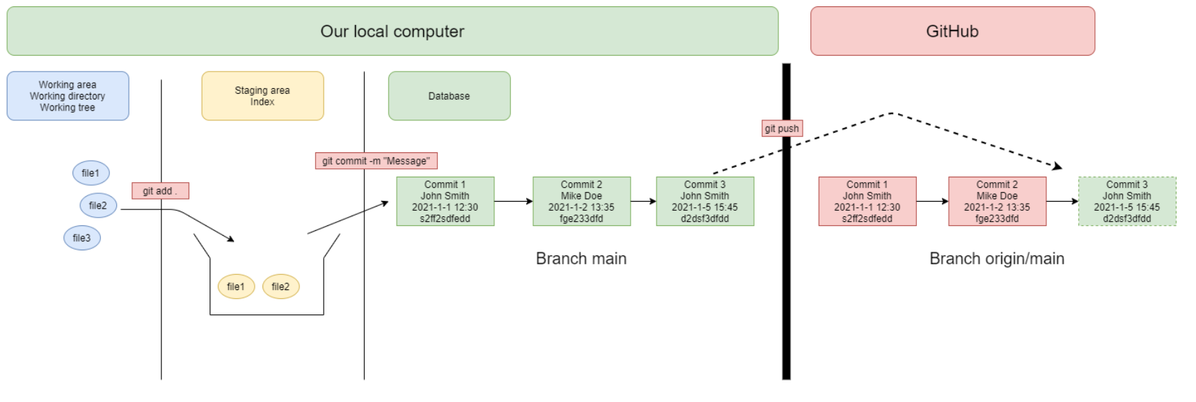
Git – moving changes to the server
There is one more important command which allows us to move our changes to the remove server.
git push

Slide 39
Additional sources about git
https://www.youtube.com/watch?v=Ebe9D5zRkvM
https://www.youtube.com/watch?v=SWYqp7iY_Tc
https://www.youtube.com/watch?v=D6EI7EbEN4Q&list=PLjHmWifVUNMKIGHmaGPVqSD-L6i1Zw-MH
In additional PDF that will be uploaded with this presentation you can find a cheatsheet with useful git commands

Slide 40
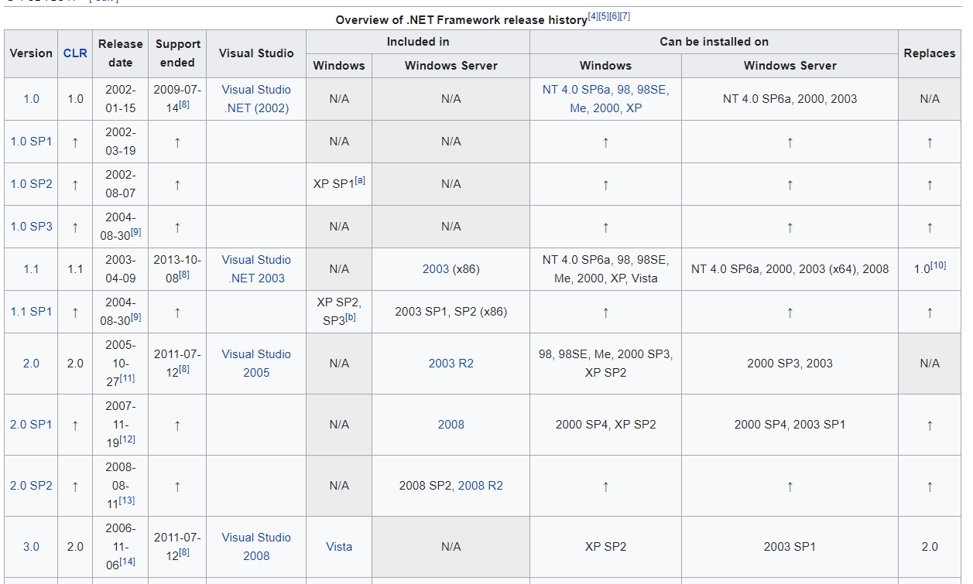
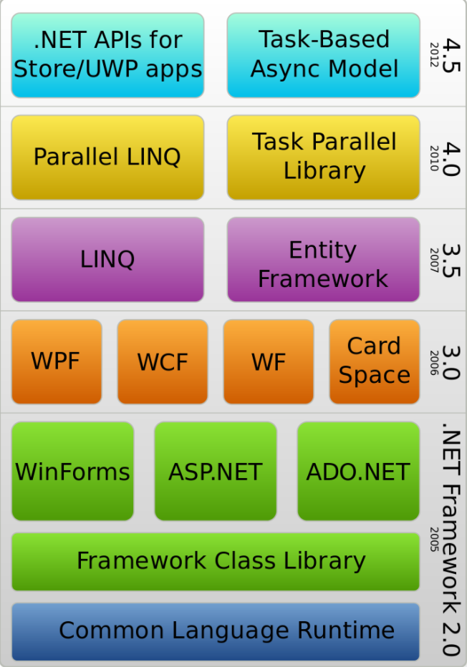
.NET basics
.NET 5, .NET Framework, .NET Core, Xamarin – are related and overlapping platforms for developers used to build applications and services

Slide 41
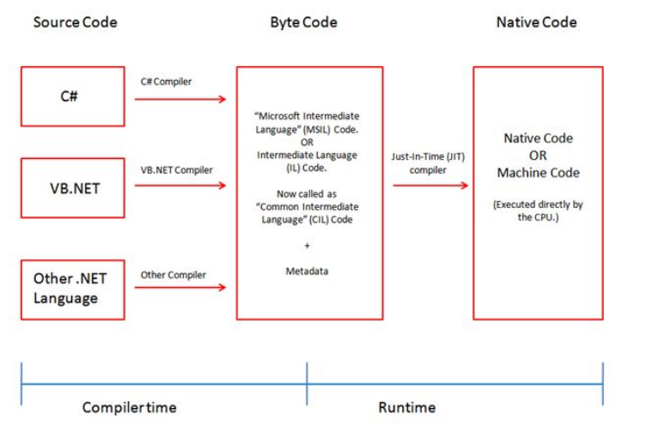
.NET Framework
.NET Framework is a development platform that includes a Common Language Runtime (CLR) and Base Class Library (BCL)
.NET Framework was originally designed to be cross-platform

Slide 42
.NET Framework 4.5.2
Since .NET Framework 4.5.2 it became an official component of Windows operating system
All the apps on a computer written in .NET Framework share the same versin of the CLR and libraries stored in Global Assembly Cache (GAC), which can lead to issues if some of them need a specific version for compatibility
Practically speaking, .NET Framework is Windows-only and a legacy platform.

Slide 43
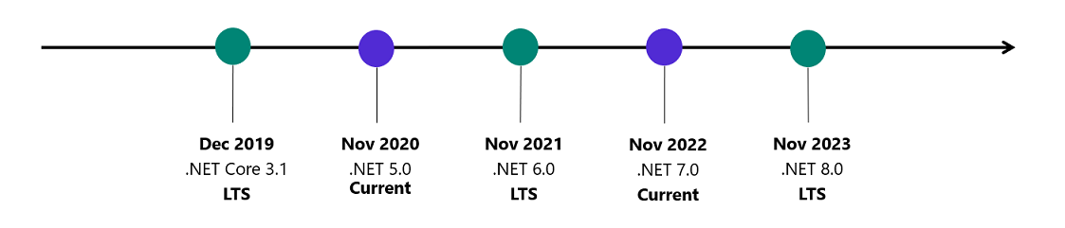
.NET Core
Microsoft started to work on decoupling the .NET from Windows
This meant rewriting a lot of the code – this version of .net was branded .NET Core
.NET Core includes a cross-platform implementation of a CLR known as CoreCRL and a streamlined library of classes known as CoreFX
At the conference in May 2020, the .NET team announced that their plan for the unification of .NET had been delayed
The schedule .NET 5 to be released November 10, 2020 and it would unify all the various .NET platforms except mobile.

Slide 44
.NET runtime and SDK versions
.NET Runtime versioning follows semantic versioning
https://semver.org/lang/pl/
.NET SDK does not follow semantic versioning

Slide 45
Differences between .NET Core and .NET 5
Use .NET 5 for your server application when:
You have cross-platform needs.
You're targeting microservices.
You're using Docker containers.
You need high-performance and scalable systems.
You need side-by-side .NET versions per application.
Use .NET Framework for your server application when:
Your app currently uses .NET Framework (recommendation is to extend instead of migrating).
Your app uses third-party .NET libraries or NuGet packages not available for .NET 5.
Your app uses .NET technologies that aren't available for .NET 5.
Your app uses a platform that doesn't support .NET 5.

Slide 46
What is a .net Standard?
Microsoft at some point had to suport three forked platforms for programming:
.NET Core
.NET Framework
Xamarin
.NET Standard is a specification for a set of APIs that all .NET platforms could implement to indicate what level of compatibility they have.
By the end of 2021, Microsoft promises that there will be a single .NET platform
.NET 6 is planned to have a single BCL and two runtimes: one optimized for server or desktop scenarios and one optimized for mobile apps on the Xamarin runtime.

Slide 47
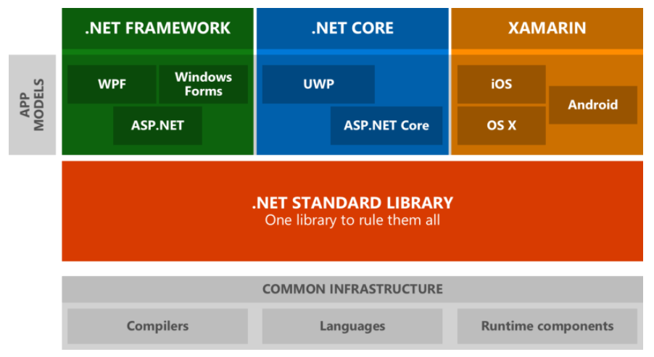
.NET Standard

Slide 48
C# language
C# is a modern, object-oriented, and type-safe programming language.
C# has its roots in the C family of languages and will be immediately familiar to C, C++, Java, and JavaScript programmers.
C# is an object-oriented, component-oriented programming language.
Garbage collection - automatically reclaims memory occupied by unreachable unused objects.
C# programs run on .NET, a virtual execution system called the common language runtime (CLR) and a set of class libraries.
The CLR is the implementation by Microsoft of the common language infrastructure (CLI), an international standard.

Slide 49
Visual Studio
Solution Explorer
Git Changes
Build -> Build Solution
Debug -> Start Debugging
Debug -> Start Without Debugging
Check the structure of the project on disk
Additional materials
https://www.youtube.com/watch?v=5AOp8zFu4Vg
https://www.youtube.com/watch?v=1CgsMtUmVgs

Slide 50
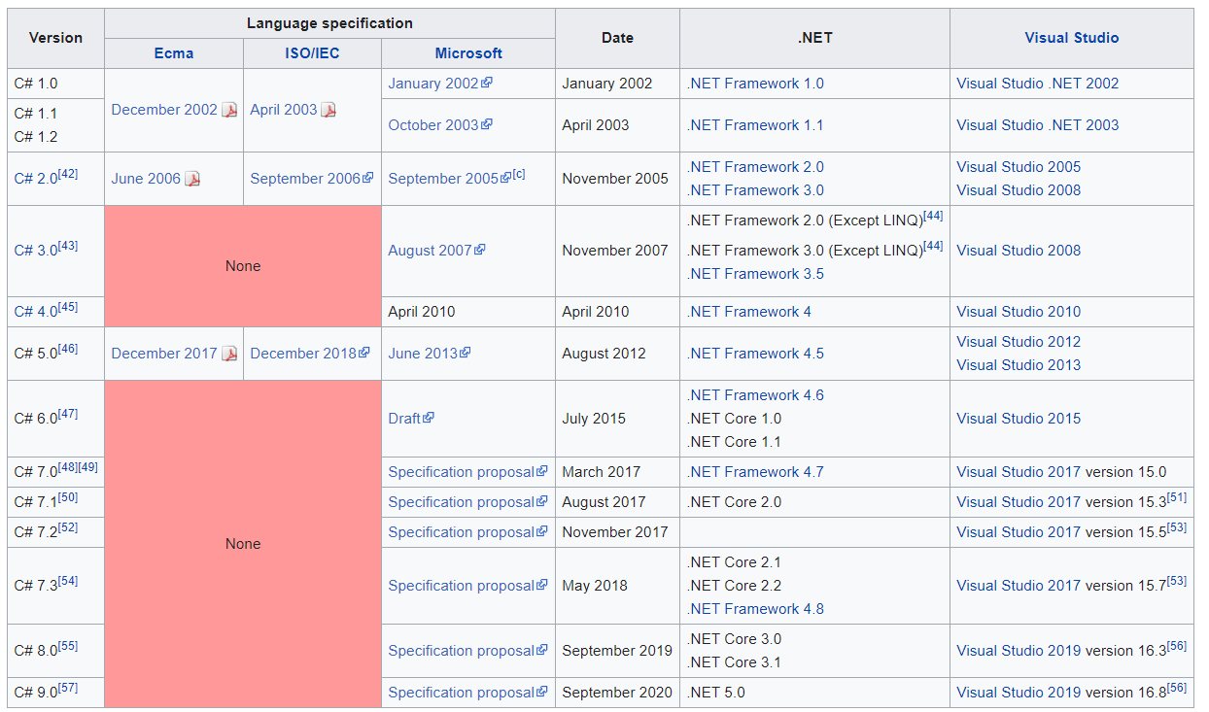
C# - history

Slide 51
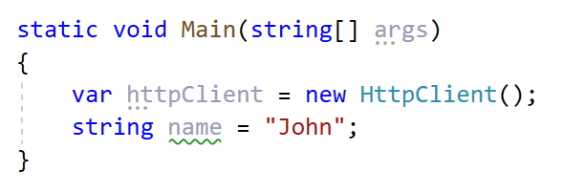
C# - syntactic sugar
C# lets you declare local variables without giving them explicit types. It is possible with the help of the “var” type variable. The “var” keyword is used to declare a var type variable.
In C#, the string keyword is an alias for String. Therefore, String and string are equivalent. The convention is however to use string.

Slide 52
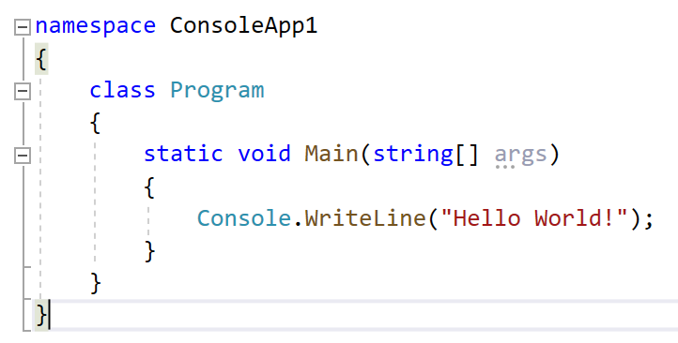
C# - namespaces
Namespaces are used in C# to organize and provide a level of separation of codes.
They can be considered as a container which consists of other namespaces, classes, etc. A namespace can have following types as its members: Namespaces (Nested Namespace)

Slide 53
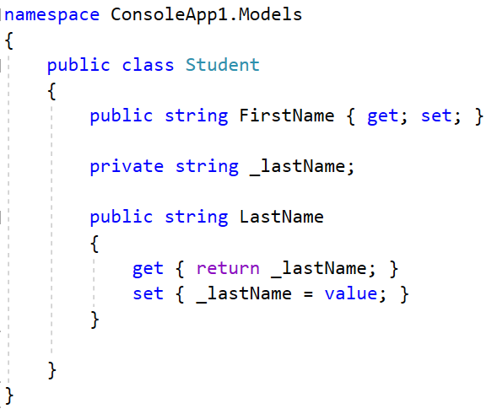
C# - properties

Slide 54
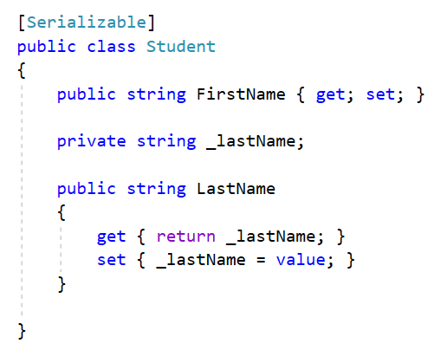
C# - attributes

Slide 55
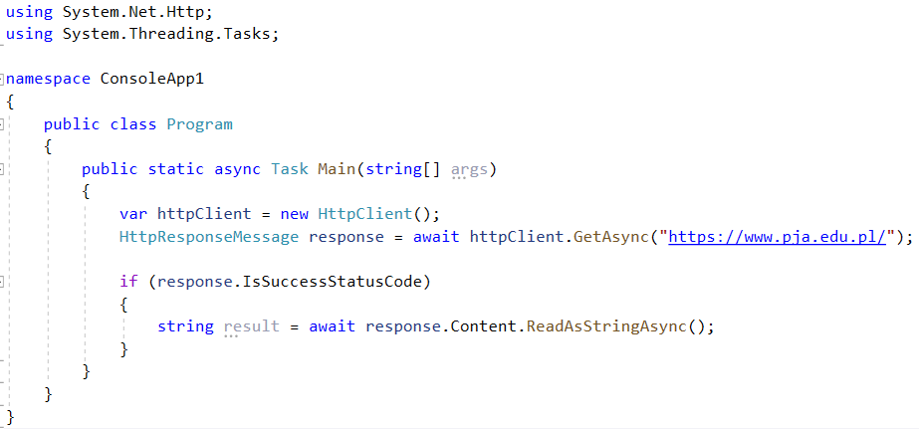
C# - help with exercise 1
Making an HTTP get request

Slide 56
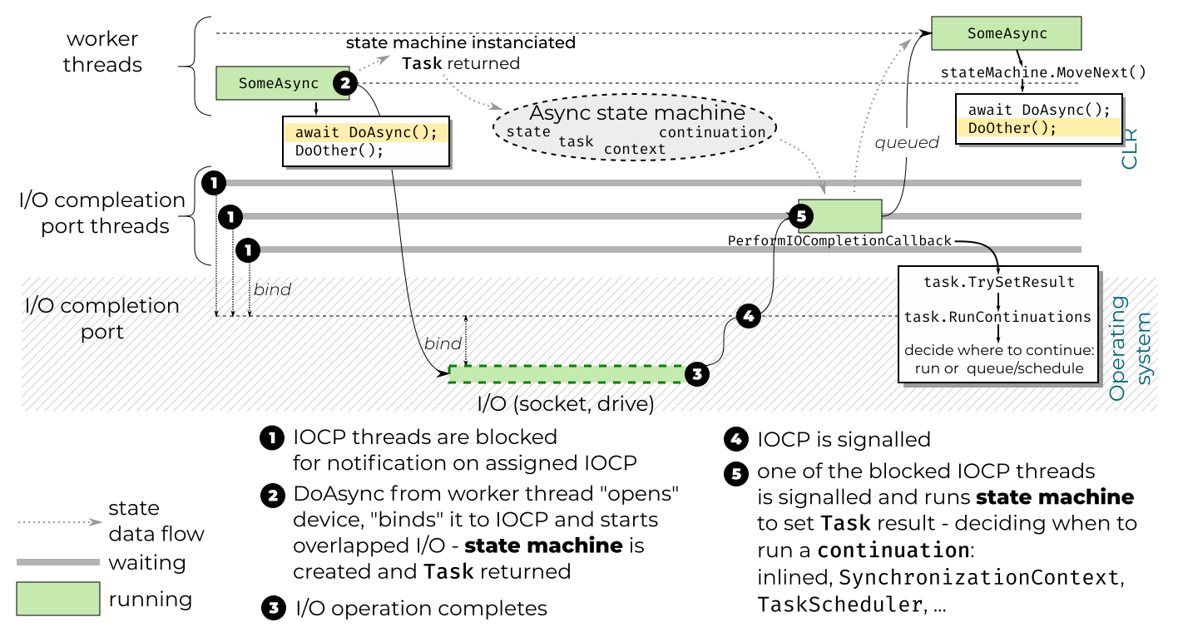
C# - async/await

Slide 57
C# - help with exercise 1
Try to use Regular Expressions to find all the emails within the source code.
https://docs.microsoft.com/pl-pl/dotnet/standard/base-types/regular-expressions

Slide 58
C# - coding convention
https://docs.microsoft.com/en-us/dotnet/csharp/programming-guide/inside-a-program/coding-conventions

Slide 59
Additional C# materials
https://docs.microsoft.com/pl-pl/dotnet/csharp/
https://www.youtube.com/watch?v=gfkTfcpWqAY
https://www.w3schools.com/cs/

